Slide 1
Forward model
07/31/2023
Yu Li

Slide 2
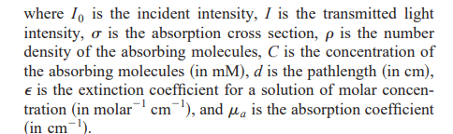

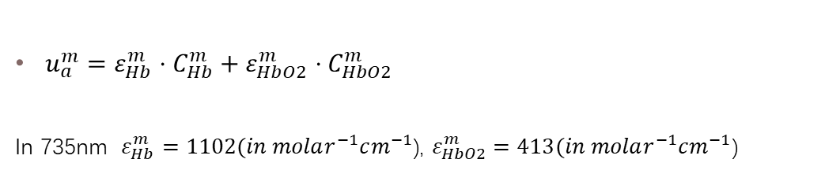
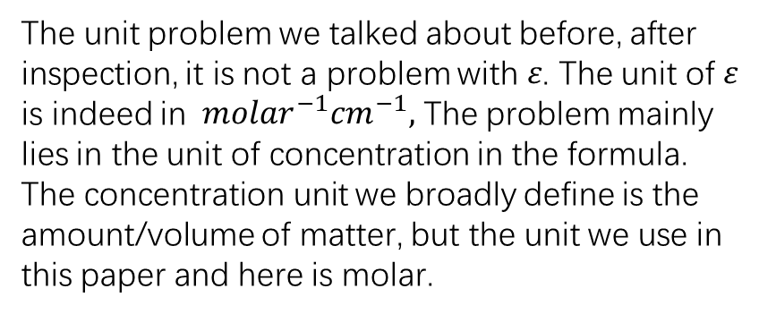
Units
Reference:
$u_{a}^{m}=ε_{Hb}^{m}⋅C_{Hb}^{m}+ε_{HbO2}^{m}⋅C_{HbO2}^{m}$
In 735nm $ε_{Hb}^{m}=\text{11}02(in molar^{−1}cm^{−1}$), $ε_{HbO2}^{m}=\text{413}(in molar^{−1}cm^{−1}$)
The unit problem we talked about before, after inspection, it is not a problem with 𝜀. The unit of 𝜀 is indeed in $molar^{−1}cm^{−1},$ The problem mainly lies in the unit of concentration in the formula. The concentration unit we broadly define is the amount/volume of matter, but the unit we use in this paper and here is molar.

Slide 3
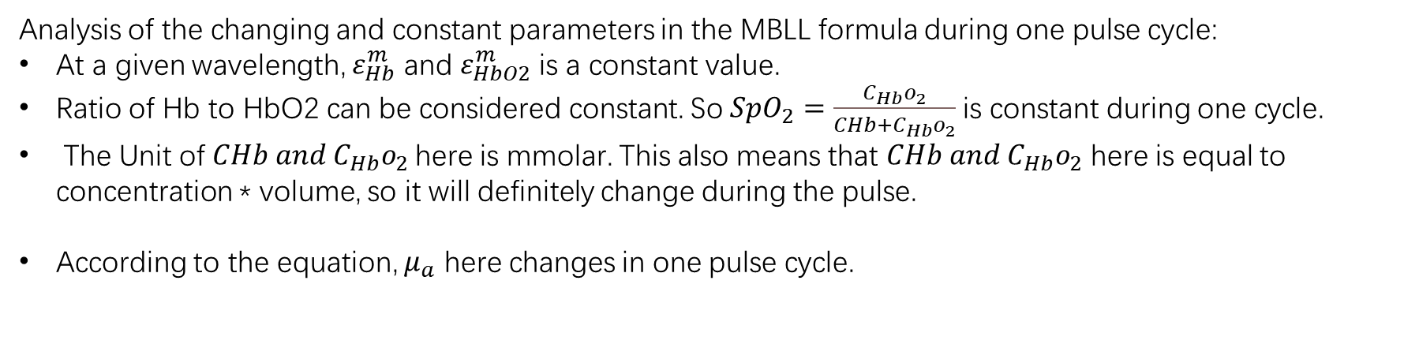
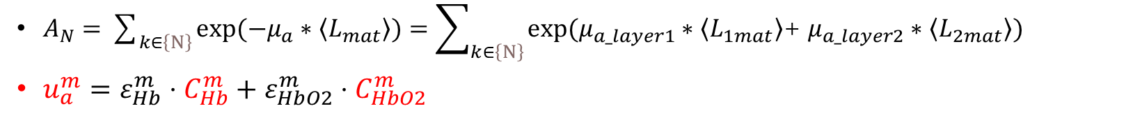
Changes in one pulse cycle
$A_{N}=\sum_{k∈\left\{N\right\}}{exp⁡(−μ_{a}∗\left\langle L_{mat}\right\rangle )}=\sum_{k∈\left\{N\right\}}{exp⁡(μ_{a_layer1}∗\left\langle L_{1mat}\right\rangle \text{+} μ_{a_layer2}∗\left\langle L_{2mat}\right\rangle )}$
$u_{a}^{m}=ε_{Hb}^{m}⋅C_{Hb}^{m}+ε_{HbO2}^{m}⋅C_{HbO2}^{m}$
Analysis of the changing and constant parameters in the MBLL formula during one pulse cycle:
At a given wavelength, $ε_{Hb}^{m}$ and $ε_{HbO2}^{m}$ is a constant value.
Ratio of Hb to HbO2 can be considered constant. So$SpO_{2}=\frac{C_{Hb}o_{2}}{CHb+C_{Hb}o_{2}}$ is constant during one cycle.
The Unit of $CHb and C_{Hb}o_{2}$here is mmolar. This also means that $CHb and C_{Hb}o_{2}$ here is equal to concentration * volume, so it will definitely change during the pulse.
According to the equation, $μ_{a}$ here changes in one pulse cycle.

Slide 4
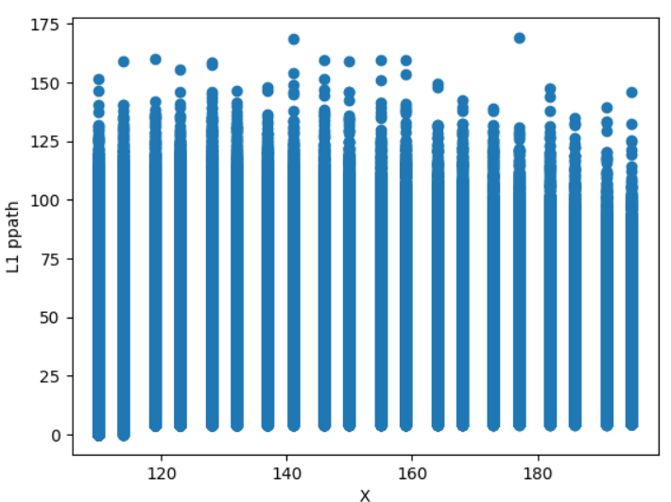
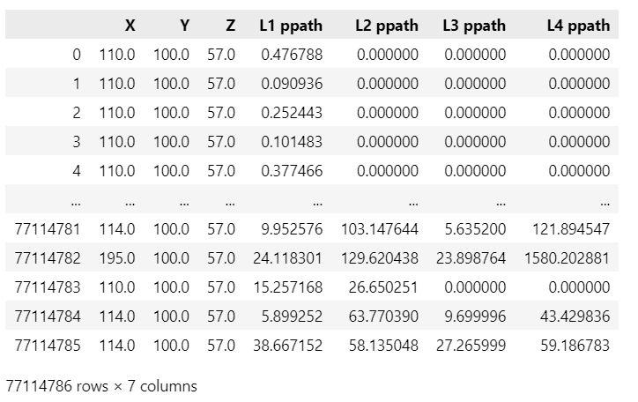
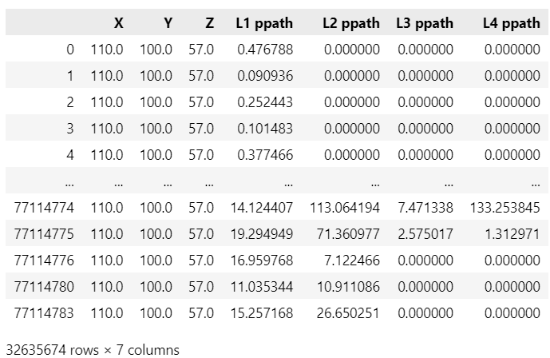
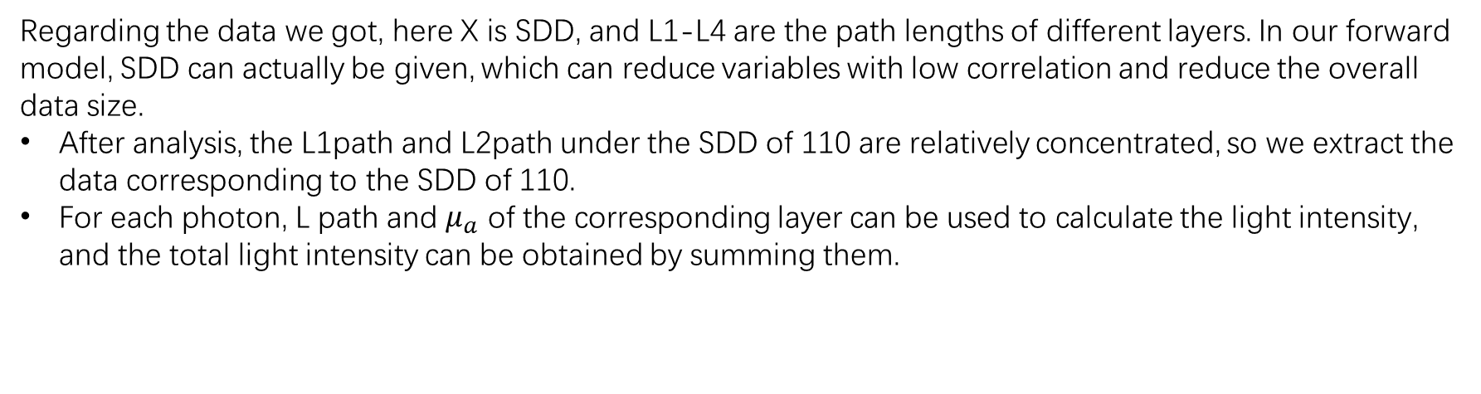
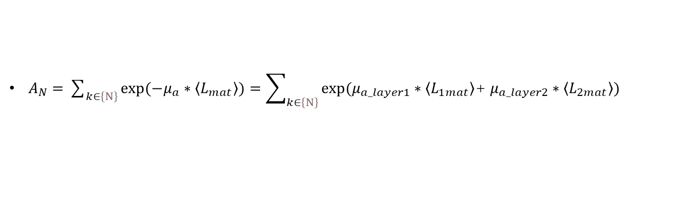
$A_{N}=\sum_{k∈\left\{N\right\}}{exp⁡(−μ_{a}∗\left\langle L_{mat}\right\rangle )}=\sum_{k∈\left\{N\right\}}{exp⁡(μ_{a_layer1}∗\left\langle L_{1mat}\right\rangle \text{+} μ_{a_layer2}∗\left\langle L_{2mat}\right\rangle )}$
Regarding the data we got, here X is SDD, and L1-L4 are the path lengths of different layers. In our forward model, SDD can actually be given, which can reduce variables with low correlation and reduce the overall data size.
After analysis, the L1path and L2path under the SDD of 110 are relatively concentrated, so we extract the data corresponding to the SDD of 110.
For each photon, L path and $μ_{a}$ of the corresponding layer can be used to calculate the light intensity, and the total light intensity can be obtained by summing them.

Slide 5
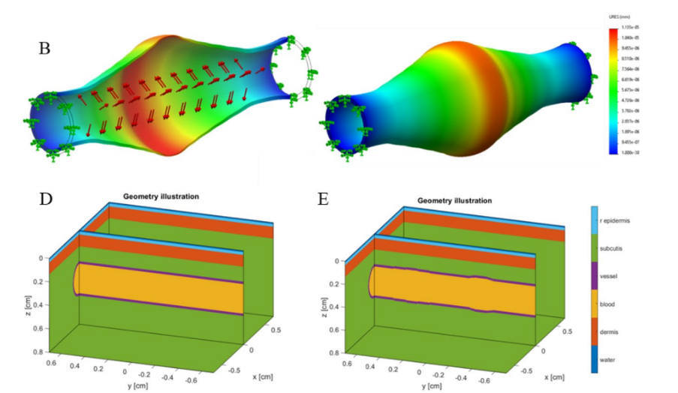
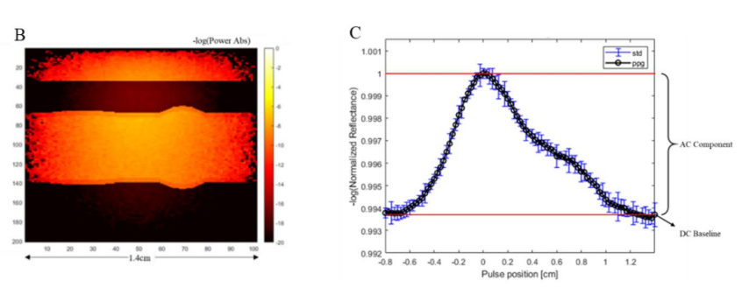
How to obtain time series
Monte Carlo simulation cannot directly obtain time information, it needs to be converted. One idea is to simulate the change of a blood vessel in one cycle by modeling a section of blood vessel. The time information of the state of the blood vessel can be obtained.
The horizontal axis of the signal diagram obtained in the reference paper is the length, but it is consistent with the time domain curve of the beating singnals, which also proves that this idea is reasonable
Reference paper: Photoplethysmography (PPG) of the radial artery through parallelized Monte Carlo and its correlation to body mass index (BMI).
https://doi.org/10.1038/s41598-021-82124-4

Slide 6
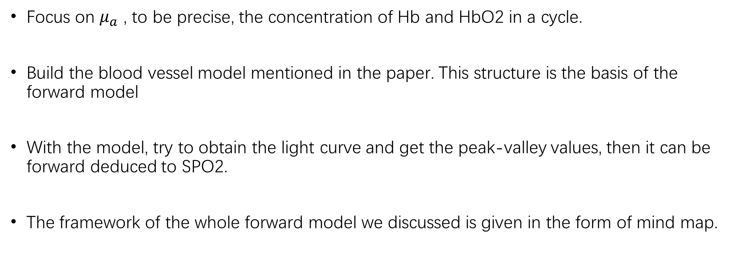
Conclusion
Focus on $μ_{a}$ , to be precise, the concentration of Hb and HbO2 in a cycle.
Build the blood vessel model mentioned in the paper. This structure is the basis of the forward model
With the model, try to obtain the light curve and get the peak-valley values, then it can be forward deduced to SPO2.
The framework of the whole forward model we discussed is given in the form of mind map.

Slide 7
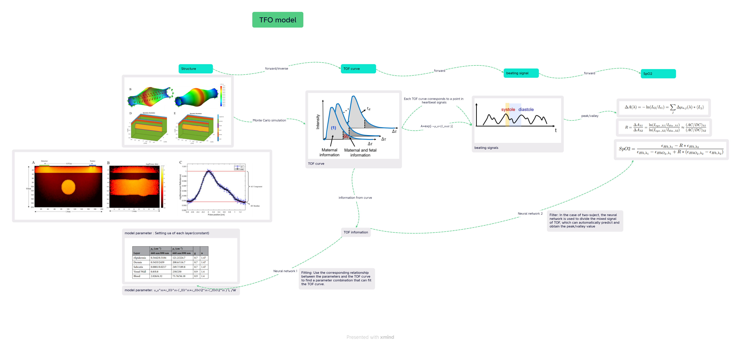
Forward model

